Slide 1
Homelumina
Find Your Perfect Place to Call Home
Dan Fitz • Filmon Mengisteab • John Suli • Roy Hung
CIS 550 - Summer 2025

Slide 2

PROBLEM & MOTIVATION
You want to move to a new place but don’t know where? Some questions you might have:
💰 Is it affordable?
🚓 Is it safe?
🏥 Is it healthy?
🧒 Are there good schools and childcare?
🏞️ What’s the quality of life like?
🔍 Our Goal: To help users compare neighborhoods and cities based on real data.
🧾 Input: A city/state or ZIP code the user is interested in
📊 Output: Aggregated statistics, similar city/ZIP suggestions, growth trends, and more!
Notes:
John

Slide 3
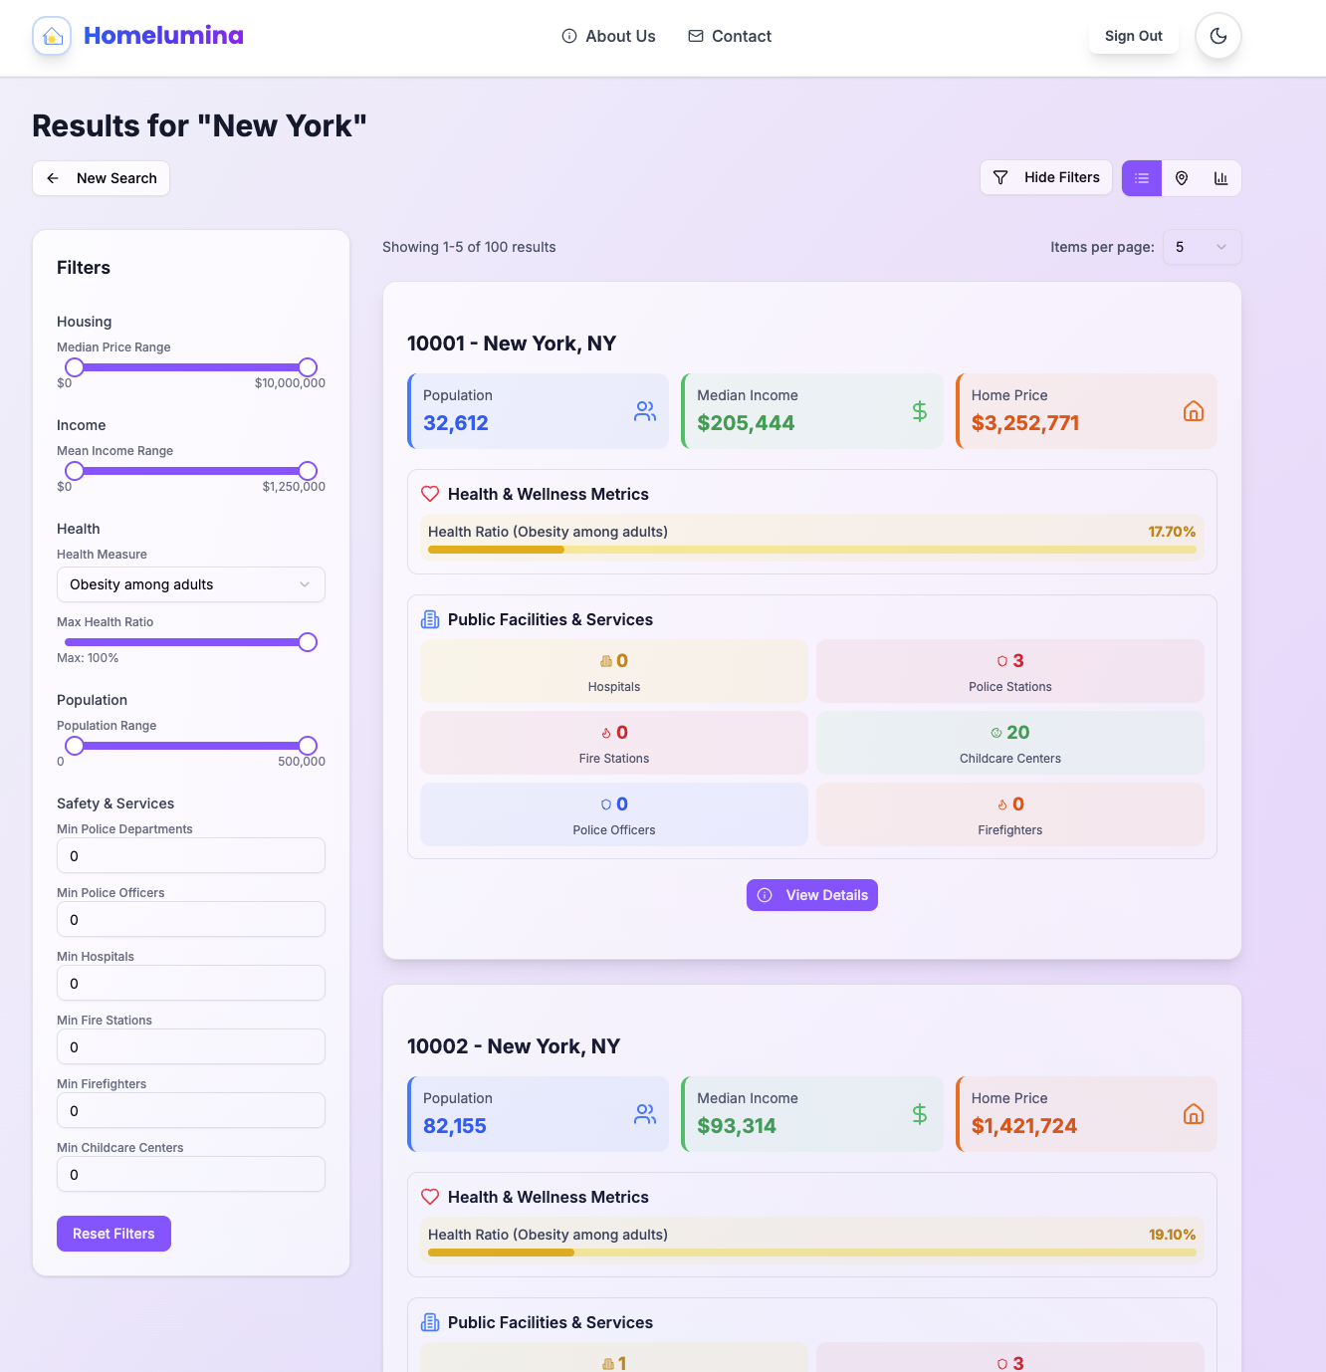
SEARCH RESULTS PAGE
Notes:
John

Slide 4
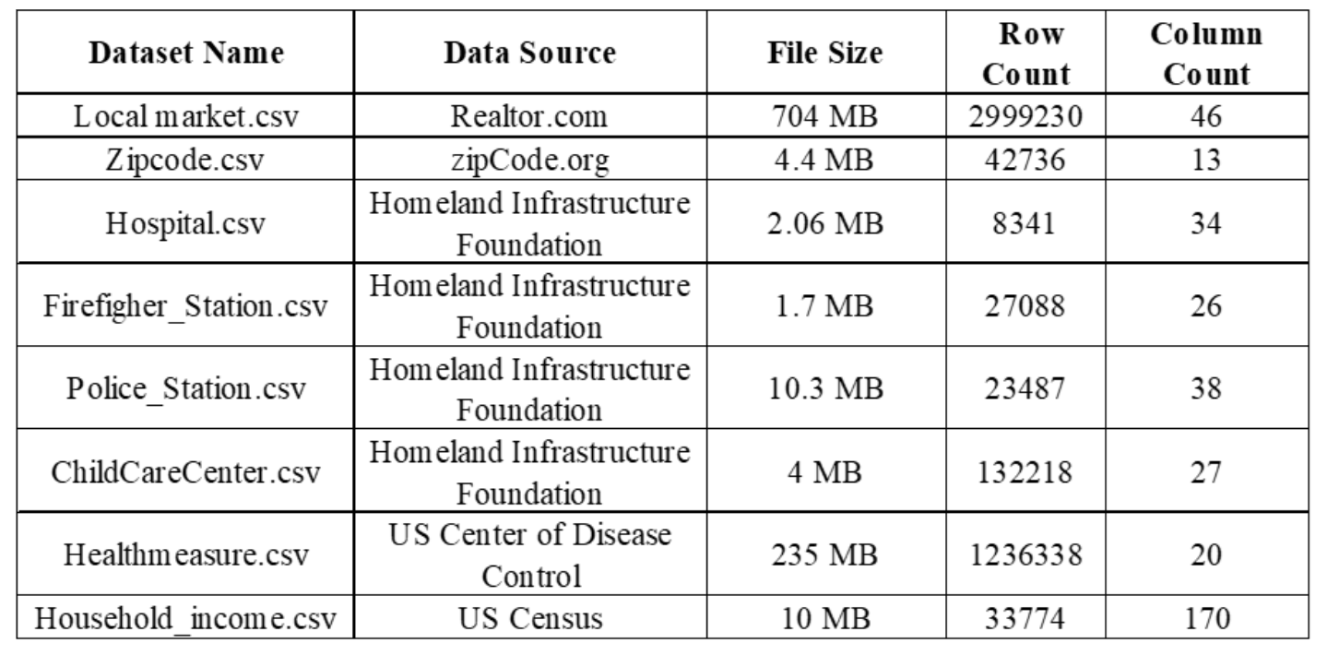
DATASETS
Notes:
John

Slide 5
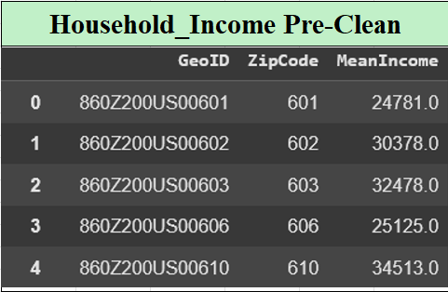
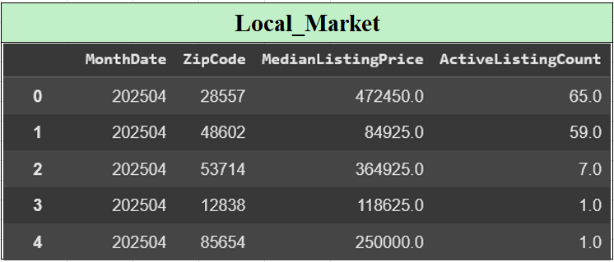
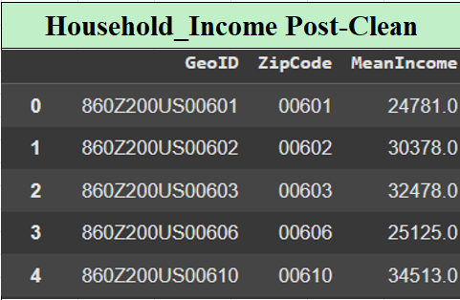
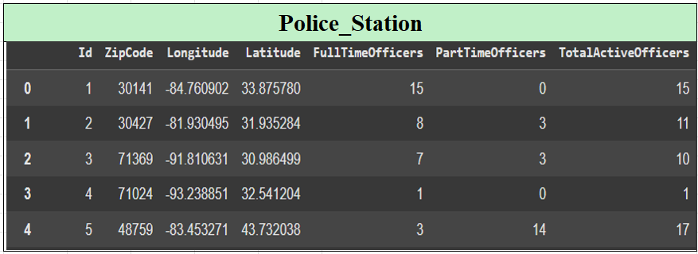
DATA PREPROCESSING & ENTITY RESOLUTION
Notes:
Roy

Slide 6
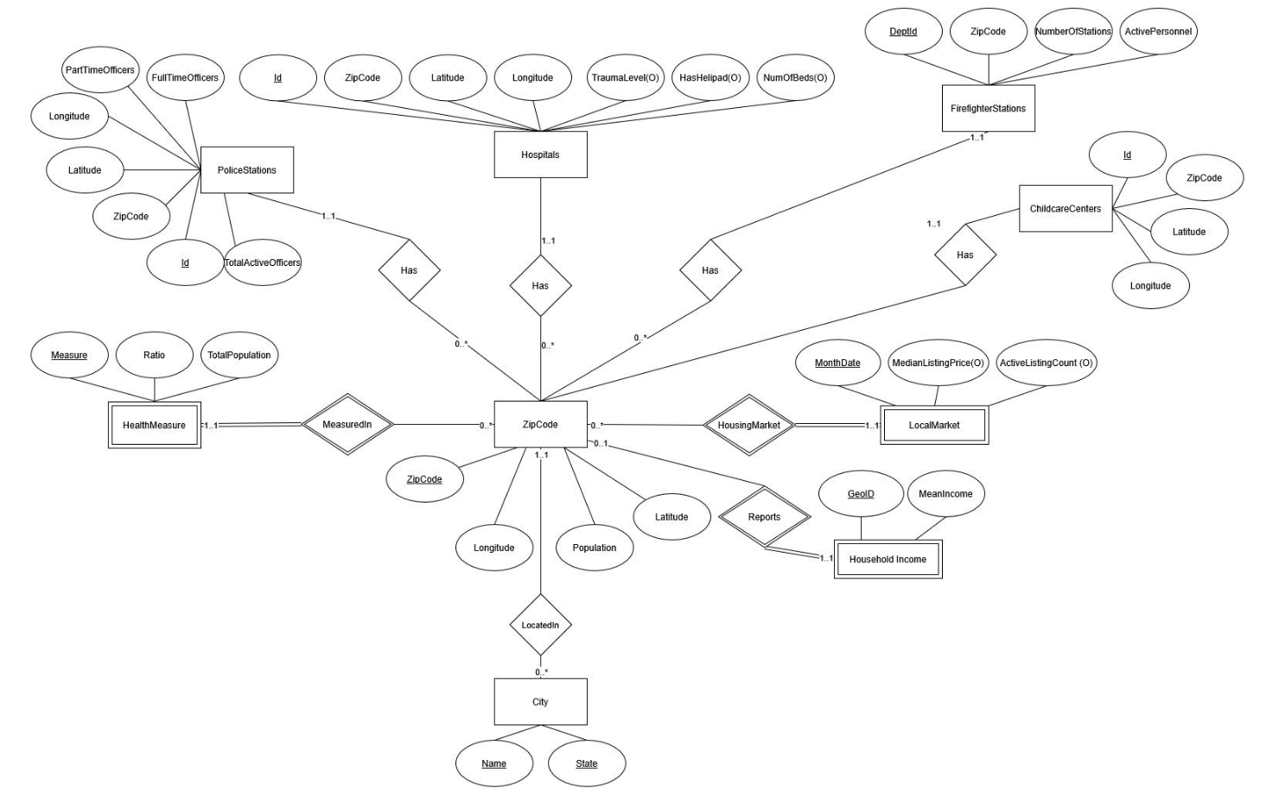
SCHEMA DESIGN
Notes:
Roy

Slide 7
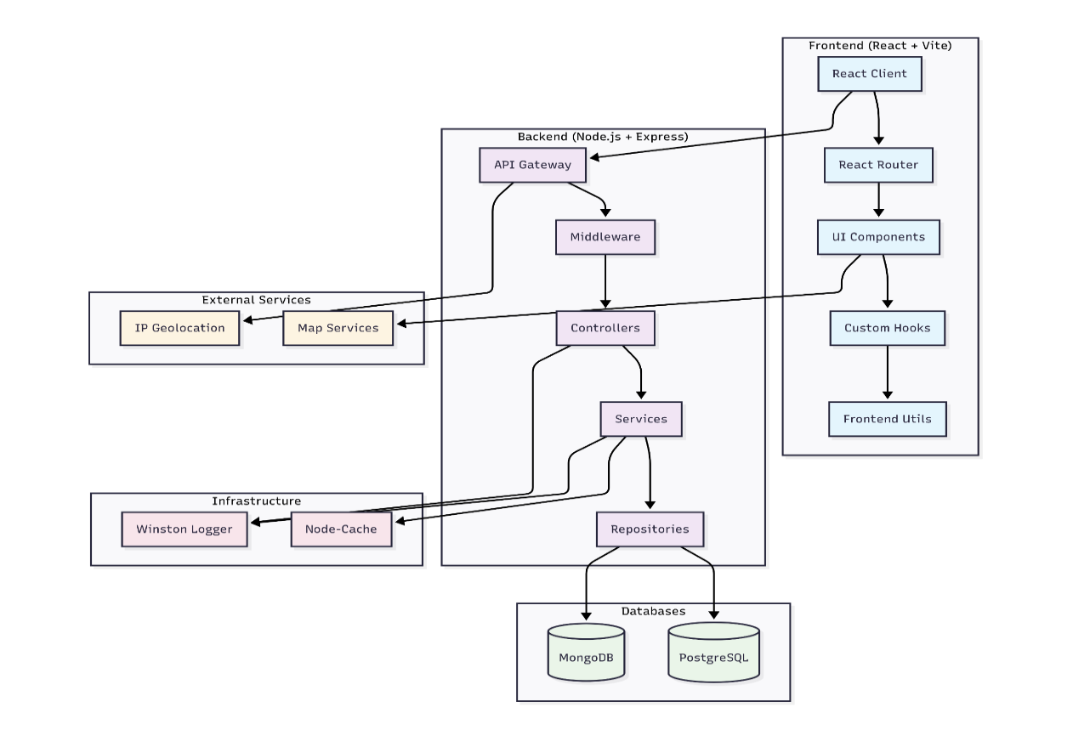
Architecture Patterns:
MVC Pattern
Repository Pattern
Middleware Pattern
Caching Strategy
Tech Stack:
-React, Typescript , UI & Visualizations -Node, Express
APPLICATION ARCHITECTURE & TECH STACK
Notes:
Filmon

Slide 8
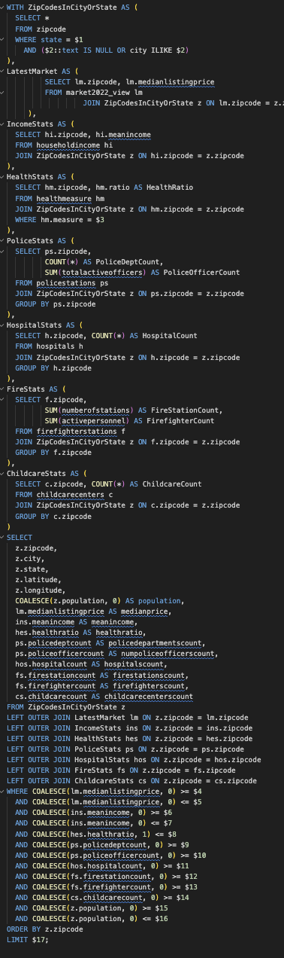
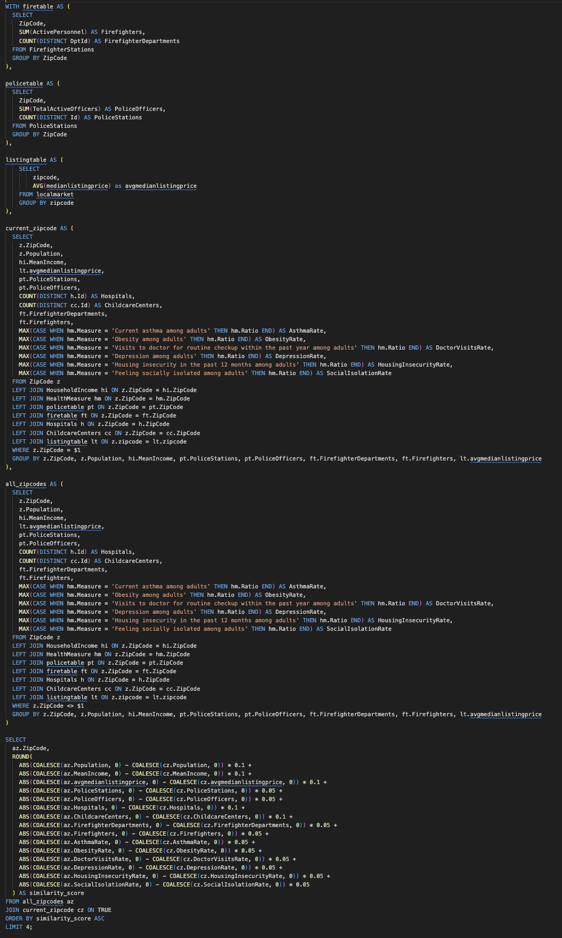
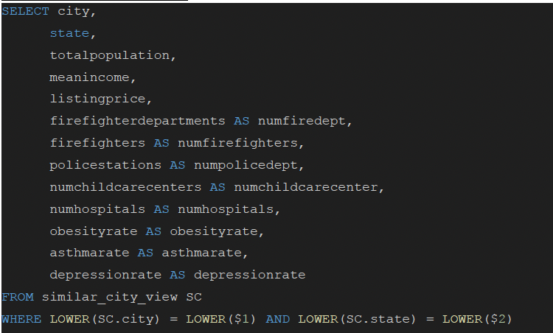
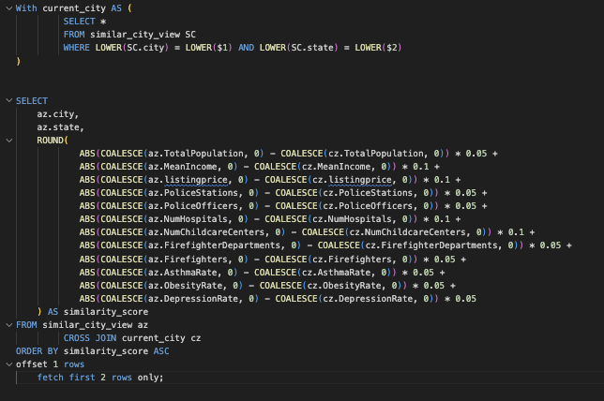
COMPLEX QUERIES
/api/v1/search/zipcode-summaries
Populates the list of ZIP codes displayed in the search results page—with over 15 filter options
/api/v1/analytics/similar-zipcodes/:zipcode
Finds the 4 most similar zip codes based on a weighted calculation for the given zip code
/api/v1/analytics/city-aggregate-comparison
Aggregate all housing, police, childcare, hospitals and other data for all ZIP codes within a city.
/api/v1/analytics/similar-cities/:city/:state
Find two similar cities from the input city that was used in the city aggregate comparison.
Notes:
Filmon

Slide 9
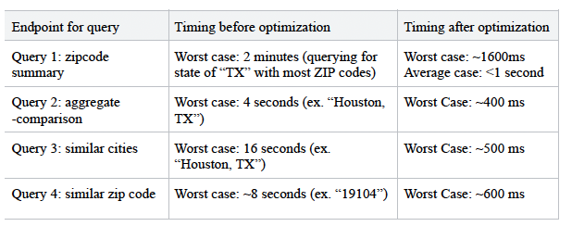
PERFORMANCE
Materialized Views:
Created for expensive, frequently used aggregations
Greatly reduced query times (query 3 & 4)
Indexing:
Indexed high-traffic columns like zipcode, city, and state
Improved lookup and join performance
Query Optimization:
Refactored complex CTE-heavy queries into fewer joins/subqueries
Caching:
Cached featured cities data to avoid redundant computation
Notes:
Filmon

Slide 10
TECHNICAL CHALLENGES
1. Finding the Right Data
Explored multiple ideas:
Food App: too many string-based joins
NPM Trend Tracker: lacked sufficient data
Solution:
Zillow-like location app
Zip code as a key simplified joins
Rich data from public sources
3. Query Performance
2. Data Cleaning & Foreign Keys
Some tables like localmarket (~3M rows) caused major slowdowns
Slow running times >1s
Encountered foreign key violations during database population
Materialized views for expensive joins
Indexed zip code columns
Limited queries to latest month data
caching
Solution:
Solution:
Created a set of valid ZIP codes
Filtered out invalid rows in Pandas before insertion
Result: Queries ran for <1 s
Notes:
Dan

Slide 11

EXTRA CREDIT FEATURES
🔐 Username/password + SSO authentication via MongoDB (NoSQL) and Firebase
Firebase manages SSO authentication
MongoDB creates and stores user documents (from either authentication method)
Bonus features:
🧪 Jest tests for server
📍IP address-based featured cities with in-memory caching
🗺️ Map view of ZIP codes using latitude/longitude pins
📱Fully responsive on mobile, tablet, and desktop
🌑 Dark mode support based on user’s system preference
Notes:
Dan

Slide 12

THANK YOU
We hope we helped you find your place
Any questions?
‹#›

